Slide 1
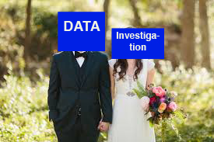
Marrying Data And Investigative Journalism Techniques
Robert Gebeloff -- @gebeloffnyt- DATAHARVEST 2016

Slide 2
Marrying Data And Investigative Journalism Techniques
Who Am I?
Journalist with 27 years of professional experience
Very traditional U.S. reporting background
Always incorporated data in my work, specialized in data journalism starting in 1997
Robert Gebeloff -- @gebeloffnyt- DATAHARVEST 2016

Slide 3
Marrying Data And Investigative Journalism Techniques
My Approach to Stories
Data journalism is not magic, it’s just another form of journalism
For all stories, we need sources:
Robert Gebeloff -- @gebeloffnyt- DATAHARVEST 2016

Slide 4
Marrying Data And Investigative Journalism Techniques
My Approach to Stories
Observation – what you see is as important as anything… set the scene, jot down details, hear, smell, count, etc.
Robert Gebeloff -- @gebeloffnyt- DATAHARVEST 2016

Slide 5
Marrying Data And Investigative Journalism Techniques
My Approach to Stories
People – finding people who know the info, getting them to tell you the info you need
Robert Gebeloff -- @gebeloffnyt- DATAHARVEST 2016

Slide 6
Marrying Data And Investigative Journalism Techniques
My Approach to Stories
Documents – Paper can be better than people – facts in black and white – court records, audits, LEAKS, etc. Your eyes can deceive you, people can lie to you, but docs are docs...
Robert Gebeloff -- @gebeloffnyt- DATAHARVEST 2016

Slide 7
Marrying Data And Investigative Journalism Techniques
My Approach to Stories
Data – Numeric information that isn’t in narrative form; raw information that hasn’t been summarized or otherwise processed – journalists become social scientists, find the news
Robert Gebeloff -- @gebeloffnyt- DATAHARVEST 2016

Slide 8
Marrying Data And Investigative Journalism Techniques
So what is Data Journalism?
????????
Robert Gebeloff -- @gebeloffnyt- DATAHARVEST 2016

Slide 9

Marrying Data And Investigative Journalism Techniques
So what is Data Journalism?
????????
Robert Gebeloff -- @gebeloffnyt- DATAHARVEST 2016

Slide 10
Marrying Data And Investigative Journalism Techniques
Ok… I was a data blogger too once...
Robert Gebeloff -- @gebeloffnyt- DATAHARVEST 2016

Slide 11
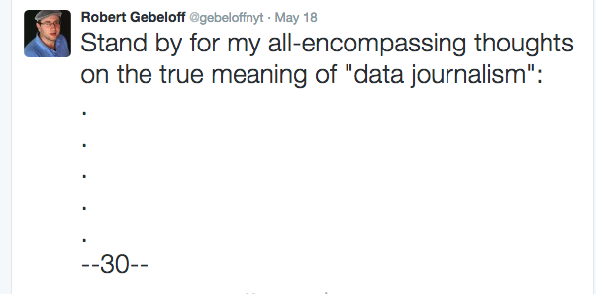
Marrying Data And Investigative Journalism Techniques
So what is Data Journalism?
Robert Gebeloff -- @gebeloffnyt- DATAHARVEST 2016

Slide 12
Marrying Data And Investigative Journalism Techniques
So what is Data Journalism?
I reject the notion that “Data Journalism” is any one thing.
Robert Gebeloff -- @gebeloffnyt- DATAHARVEST 2016

Slide 13
Marrying Data And Investigative Journalism Techniques
So what is Data Journalism?
I kind of, somewhat, really don’t like the term “Data Journalism”
Robert Gebeloff -- @gebeloffnyt- DATAHARVEST 2016

Slide 14
Marrying Data And Investigative Journalism Techniques
So what is Data Journalism?
But…
Robert Gebeloff -- @gebeloffnyt- DATAHARVEST 2016

Slide 15
Marrying Data And Investigative Journalism Techniques
So what is Data Journalism?
That being said, it’s really nice after so many years of being a “Data Journalist”, what I do is officially a THING…..
Robert Gebeloff -- @gebeloffnyt- DATAHARVEST 2016

Slide 16
Marrying Data And Investigative Journalism Techniques
So what is Data Journalism?
So as an old-school editor might request, I will stop TELLING you about it and SHOW you something….
Robert Gebeloff -- @gebeloffnyt- DATAHARVEST 2016

Slide 17
Marrying Data And Investigative Journalism Techniques
Data Journalism at The New York Times
CAR Team – five journalists that specialize in stories involving data analysis
Robert Gebeloff -- @gebeloffnyt- DATAHARVEST 2016

Slide 18
Marrying Data And Investigative Journalism Techniques
Data Journalism at The New York Times
Graphics -- a large and growing group of journalists that specialize in creating visuals for stories, but increasingly, telling visual stories
Robert Gebeloff -- @gebeloffnyt- DATAHARVEST 2016

Slide 19
Marrying Data And Investigative Journalism Techniques
Data Journalism at The New York Times
The Upshot – a stand-alone section on NYTimes.com that features analytical stories and visuals
Robert Gebeloff -- @gebeloffnyt- DATAHARVEST 2016

Slide 20
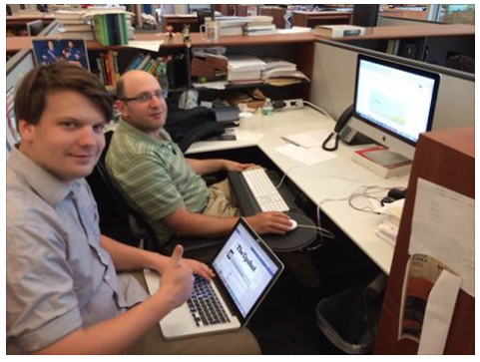
Marrying Data And Investigative Journalism Techniques
Data Journalism at The New York Times
Robert Gebeloff -- @gebeloffnyt- DATAHARVEST 2016

Slide 21
Marrying Data And Investigative Journalism Techniques
Data Journalism at The New York Times
Interactive News -- a group of journalists who come from the world of development, they specialize in building apps and tools
Robert Gebeloff -- @gebeloffnyt- DATAHARVEST 2016

Slide 22
Marrying Data And Investigative Journalism Techniques
Data Journalism at The New York Times
Individual Reporters – there is a growing cadre of reporters at The Times who incorporate data analysis into their work using their own data skills
Robert Gebeloff -- @gebeloffnyt- DATAHARVEST 2016

Slide 23
Marrying Data And Investigative Journalism Techniques
Back to Me Again
So in my work, the one thing I should emphasize is that, in my usual hierarchy, the story drives the data inquiry, not the other way around…
Robert Gebeloff -- @gebeloffnyt- DATAHARVEST 2016

Slide 24
Marrying Data And Investigative Journalism Techniques
Back to Me Again
We have some of the best journalists in the world – they have some of the best story ideas in the world
Robert Gebeloff -- @gebeloffnyt- DATAHARVEST 2016

Slide 25
Marrying Data And Investigative Journalism Techniques
Back to Me Again
My job is to intervene and help them make a good story better, more authoritative.
Robert Gebeloff -- @gebeloffnyt- DATAHARVEST 2016

Slide 26
Marrying Data And Investigative Journalism Techniques
Back to Me Again
I rarely start out with a dataset and say, “Let’s go looking for an investigative story!”
Robert Gebeloff -- @gebeloffnyt- DATAHARVEST 2016

Slide 27
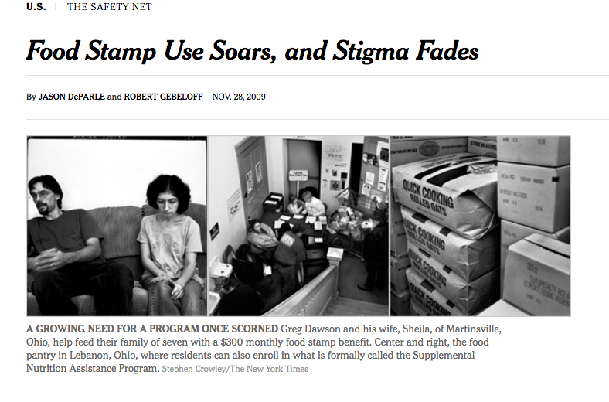
Marrying Data And Investigative Journalism Techniques
EXAMPLES
Robert Gebeloff -- @gebeloffnyt- DATAHARVEST 2016

Slide 28
Marrying Data And Investigative Journalism Techniques
Backstory: A veteran reporter on poverty issues theorizes that during the 2008 U.S. recession, food aide was not only increasing but having an outsized impact in new communities. BUT….
Robert Gebeloff -- @gebeloffnyt- DATAHARVEST 2016

Slide 29
Marrying Data And Investigative Journalism Techniques
The U.S. Federal Govt does not collect LOCAL data on food stamp use. He realizes he will need to file 50 records requests with 50 different U.S. state agencies.
Robert Gebeloff -- @gebeloffnyt- DATAHARVEST 2016

Slide 30
Marrying Data And Investigative Journalism Techniques
My role as a data journalist for this story:
-- Create system for tracking records requests
-- Parsing information as it arrived from different formats – text, xls, PDF
-- Standardizing information. Are we talking about total people who received aide for the month, or people receiving it at a given moment in time?
Robert Gebeloff -- @gebeloffnyt- DATAHARVEST 2016

Slide 31
Marrying Data And Investigative Journalism Techniques
My role as a data journalist for this story:
-- Mashing up data with other records. This is one of the key tools in data journalism’s investigative tool box – joining one set of information with another.
Robert Gebeloff -- @gebeloffnyt- DATAHARVEST 2016

Slide 32
Marrying Data And Investigative Journalism Techniques
“There are 239 counties in the United States where at least a quarter of the population receives food stamps, according to an analysis of local data collected by The New York Times.”
Robert Gebeloff -- @gebeloffnyt- DATAHARVEST 2016

Slide 33
Marrying Data And Investigative Journalism Techniques
“In more than 800 counties, it helps feed one in three children.
In the Mississippi River cities of St. Louis, Memphis and New Orleans, half of the children or more receive food stamps.
Even in Peoria, Ill. — Everytown, U.S.A. — nearly 40 percent of children receive aid.”
Robert Gebeloff -- @gebeloffnyt- DATAHARVEST 2016

Slide 34
Marrying Data And Investigative Journalism Techniques
“There are about 50 small counties and a dozen sizable ones where the rolls have doubled in the last two years.
In another 205 counties, they have risen by at least two-thirds.
These places with soaring rolls include populous Riverside County, Calif., most of greater Phoenix and Las Vegas, a ring of affluent Atlanta suburbs, and a 150-mile stretch of southwest Florida from Bradenton to the Everglades.”
Robert Gebeloff -- @gebeloffnyt- DATAHARVEST 2016

Slide 35
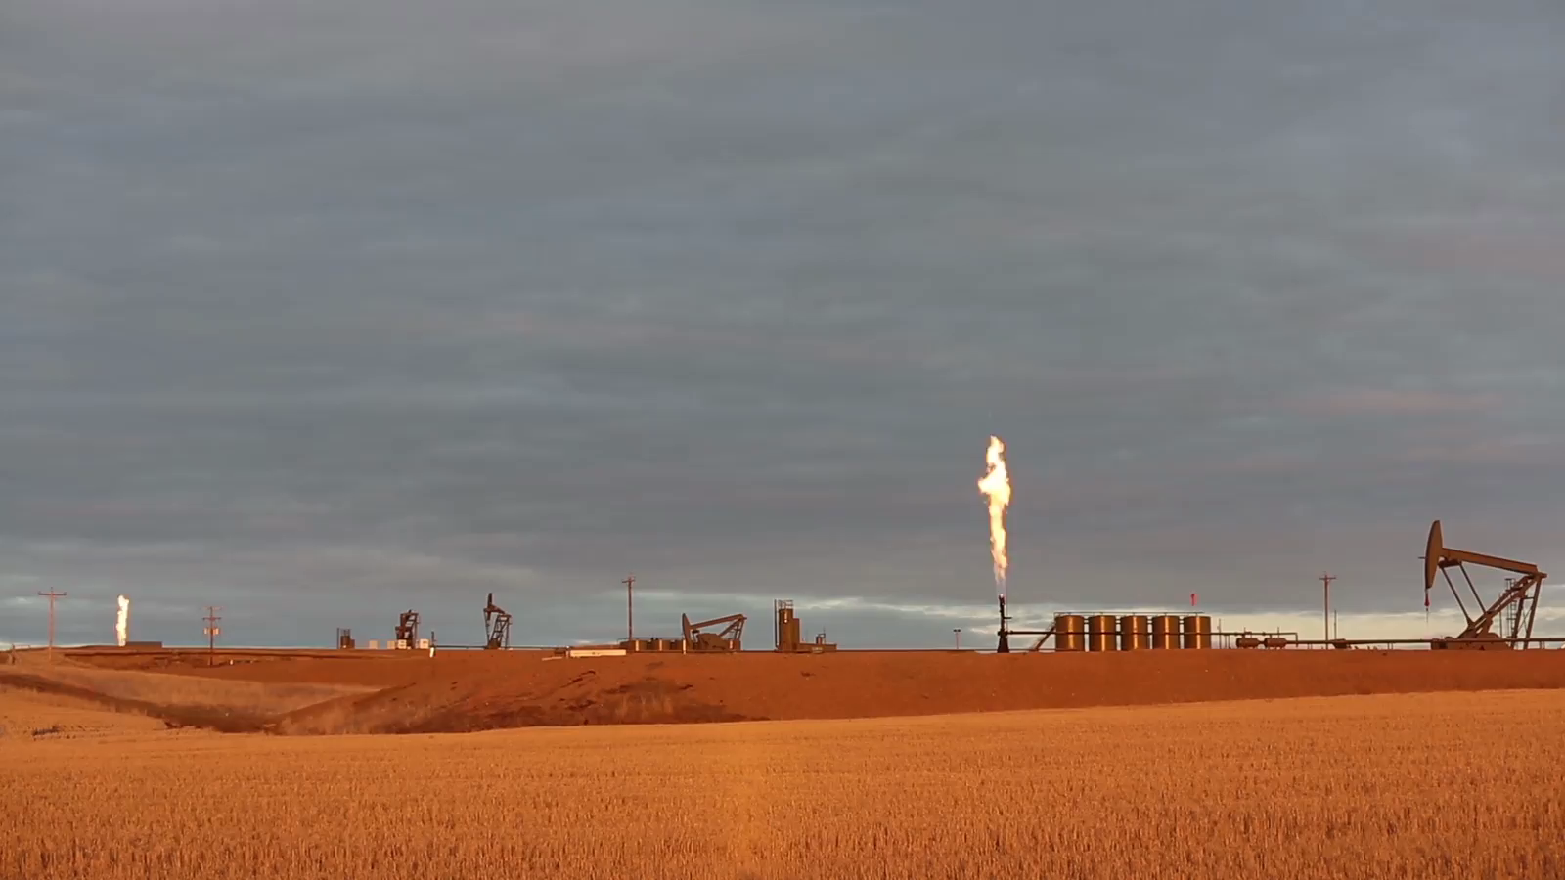
Marrying Data And Investigative Journalism Techniques
“There are about 50 small counties and a dozen sizable ones where the rolls have doubled in the last two years.
In another 205 counties, they have risen by at least two-thirds.
These places with soaring rolls include populous Riverside County, Calif., most of greater Phoenix and Las Vegas, a ring of affluent Atlanta suburbs, and a 150-mile stretch of southwest Florida from Bradenton to the Everglades.”
Robert Gebeloff -- @gebeloffnyt- DATAHARVEST 2016

Slide 36
Marrying Data And Investigative Journalism Techniques
Many stories about the economic benefits of the North Dakota oil boom
Fewer stories about the environmental issues, and those usually about individual spills or incomplete.
NYT sends correspondent to size up the situation, hoping for quick turnaround story.
Once she realizes extent of the issue, and how difficult it will be to document, she partners up with me.
Robert Gebeloff -- @gebeloffnyt- DATAHARVEST 2016

Slide 37
Marrying Data And Investigative Journalism Techniques
There were no official stats on oil spills — the Federal Government regulates pipelines, everything else is left to the states.
North Dakota had lots of public info on oil production, but it’s mostly in PDF monthly reports.
Spill incidents posted online, but only a few fields of info, and not searchable – the rest locked in PDFs.
Enforcement actions kept only in file cabinets of bureaucrats
Robert Gebeloff -- @gebeloffnyt- DATAHARVEST 2016

Slide 38
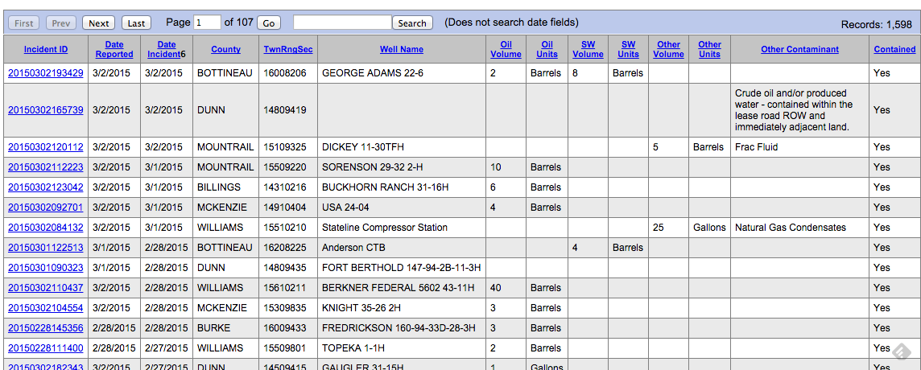
Marrying Data And Investigative Journalism Techniques
Robert Gebeloff -- @gebeloffnyt- DATAHARVEST 2016

Slide 39
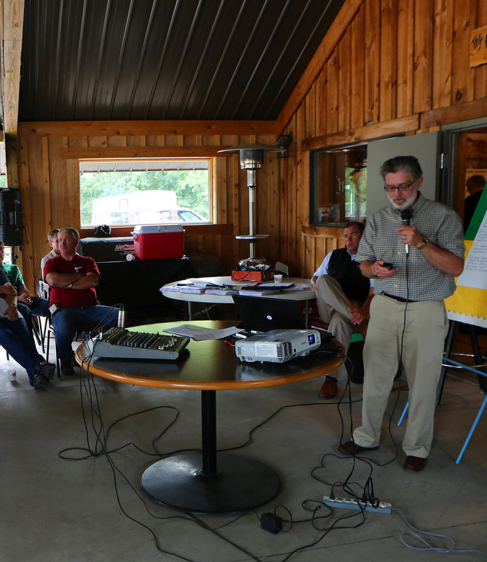
Marrying Data And Investigative Journalism Techniques
Speaking to farmers in the town of Antler, Lynn D. Helms, the director of the Department of Mineral Resources, announced “a little bit of good news”: The spill rate per well was “steady or down.”
Robert Gebeloff -- @gebeloffnyt- DATAHARVEST 2016

Slide 40
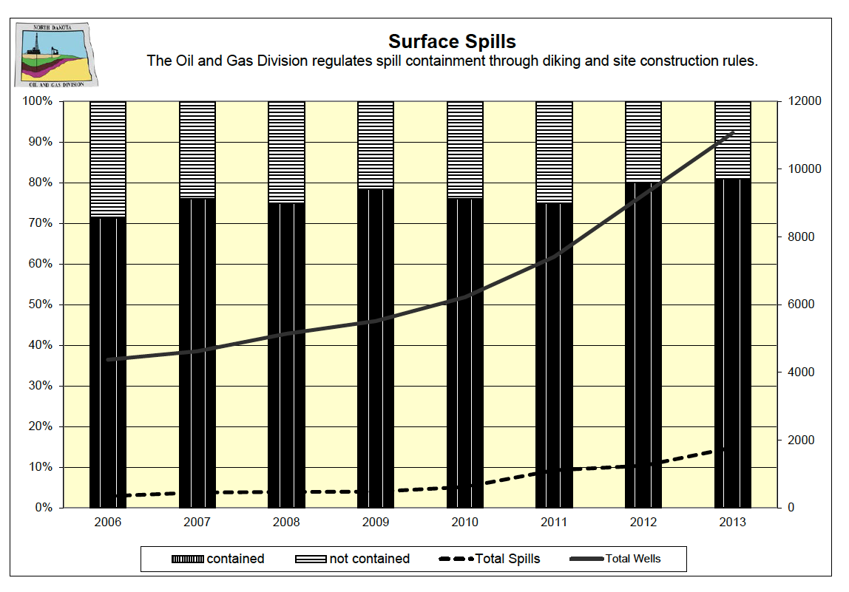
Marrying Data And Investigative Journalism Techniques
Speaking to farmers in the town of Antler, Lynn D. Helms, the director of the Department of Mineral Resources, announced “a little bit of good news”: The spill rate per well was “steady or down.”
Robert Gebeloff -- @gebeloffnyt--NICAR 2015

Slide 41
Marrying Data And Investigative Journalism Techniques
Creating Our Own Database
1) Downloading the incident records required a scraper. In this case we used a browser emulator to go through the site and download the pages
browser = Watir::Browser.new :firefox
browser.goto 'http://www.ndhealth.gov/ehs/foia/spills/defaultOGContained.aspx’
opening_page = Nokogiri::HTML.parse(browser.html)
2) Cleaning up the mess — standardizing company names, incident types, correcting errors — initial report said zero spilled, but full text of incident said something else.
Robert Gebeloff -- @gebeloffnyt- DATAHARVEST 2016

Slide 42
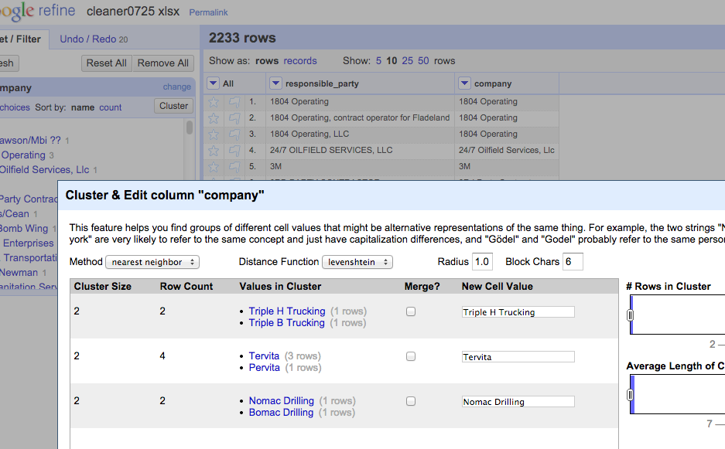
Creating Our Own Database
Robert Gebeloff -- @gebeloffnyt- DATAHARVEST 2016

Slide 43
Marrying Data And Investigative Journalism Techniques
Creating Our Own Production Data
2) Downloading monthly PDF files — able to use WGET all for this, then Monarch to parse the info
We built a list of report URLS in Excel for WGET:
https://www.dmr.nd.gov/oilgas/mpr/2006_09.pdf
https://www.dmr.nd.gov/oilgas/mpr/2006_10.pdf
https://www.dmr.nd.gov/oilgas/mpr/2006_11.pdf
https://www.dmr.nd.gov/oilgas/mpr/2006_12.pdf
https://www.dmr.nd.gov/oilgas/mpr/2007_01.pdf
Robert Gebeloff -- @gebeloffnyt- DATAHARVEST 2016

Slide 44
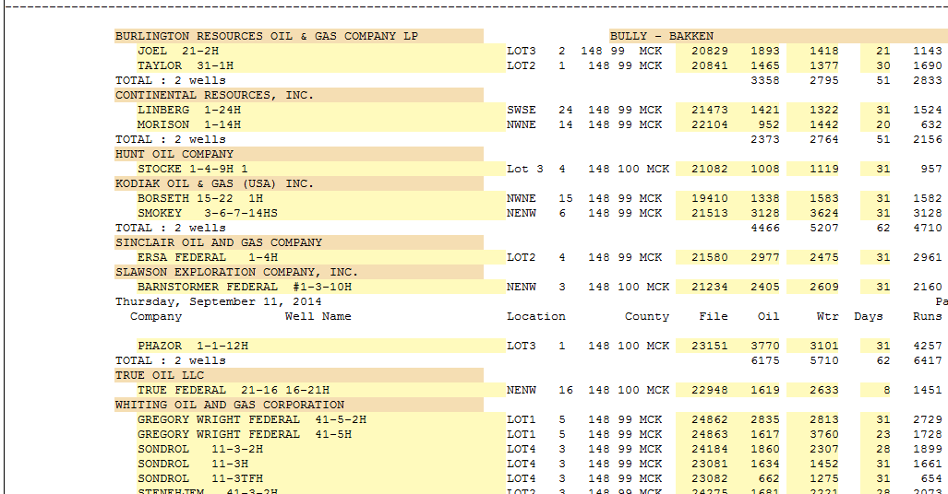
Creating Our Own Production Data
Robert Gebeloff -- @gebeloffnyt- DATAHARVEST 2016

Slide 45
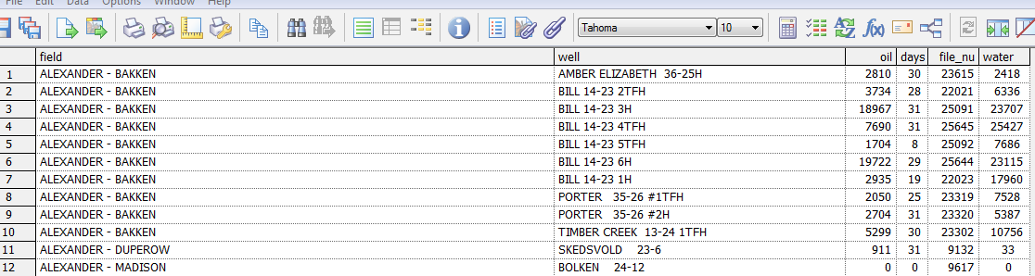
Robert Gebeloff -- @gebeloffnyt- DATAHARVEST 2016

Slide 46
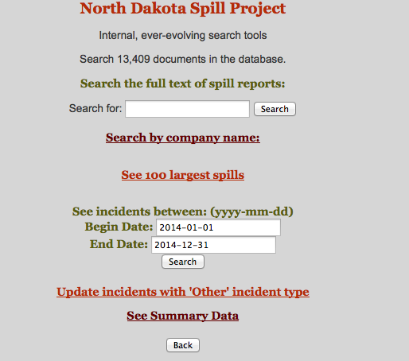
Marrying Data And Investigative Journalism Techniques
Putting It All Together
I created an internal Web site that served not just as a way to share latest data and findings with colleagues, but a way to help us split administrative tasks, and to conceptualize our analytical points.
Robert Gebeloff -- @gebeloffnyt- DATAHARVEST 2016

Slide 47
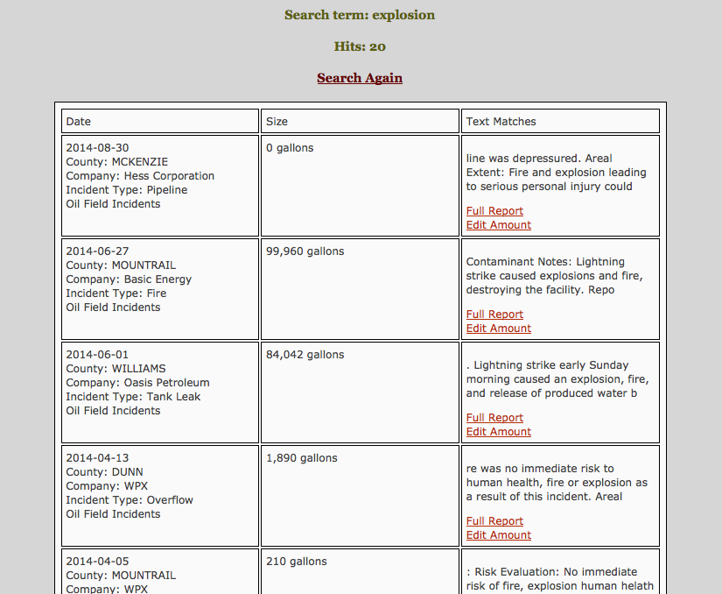
Robert Gebeloff -- @gebeloffnyt- DATAHARVEST 2016

Slide 48
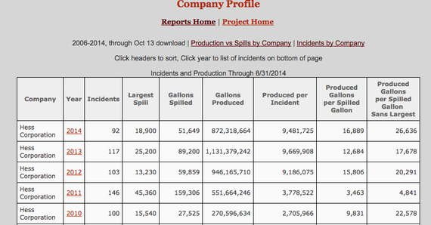
Robert Gebeloff -- @gebeloffnyt- DATAHARVEST 2016

Slide 49
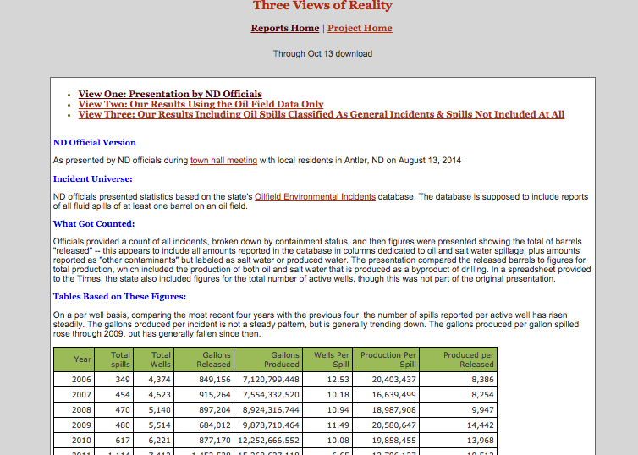
Behind The Boom
Putting It All Together
Robert Gebeloff -- @gebeloffnyt--NICAR 2015

Slide 50
Robert Gebeloff -- @gebeloffnyt--NICAR 2015

Slide 51
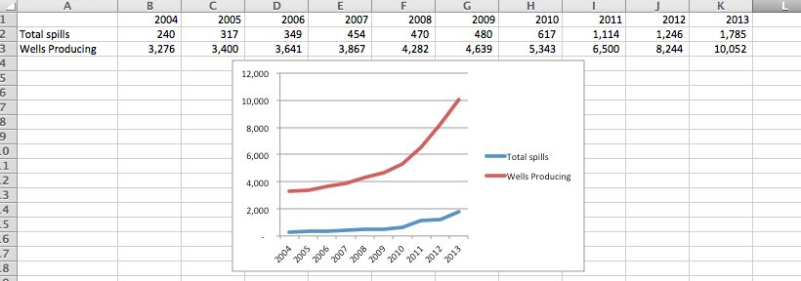
Robert Gebeloff -- @gebeloffnyt- DATAHARVEST 2016

Slide 52
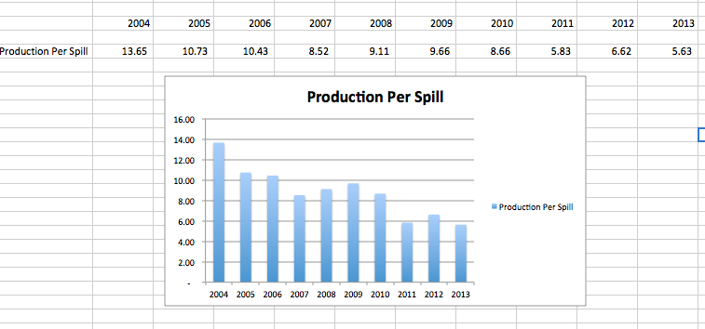
Robert Gebeloff -- @gebeloffnyt- DATAHARVEST 2016

Slide 53
Marrying Data And Investigative Journalism Techniques
ENFORCEMENT
“The Times found that the Industrial Commission wields its power to penalize the industry only as a last resort. It rarely pursues formal complaints and typically settles those for about 10 percent of the assessed penalties. “ -- what we found after pulling all the paper and typing it into a database
Robert Gebeloff -- @gebeloffnyt- DATAHARVEST 2016

Slide 54
Marrying Data And Investigative Journalism Techniques
The series itself:
http://www.nytimes.com/interactive/2014/11/23/us/north-dakota-oil-boom-downside.html
Sample code for scraping and parsing the North Dakota data
https://github.com/gebelo/nd_oil_incidents
Robert Gebeloff -- @gebeloffnyt- DATAHARVEST 2016

Slide 55
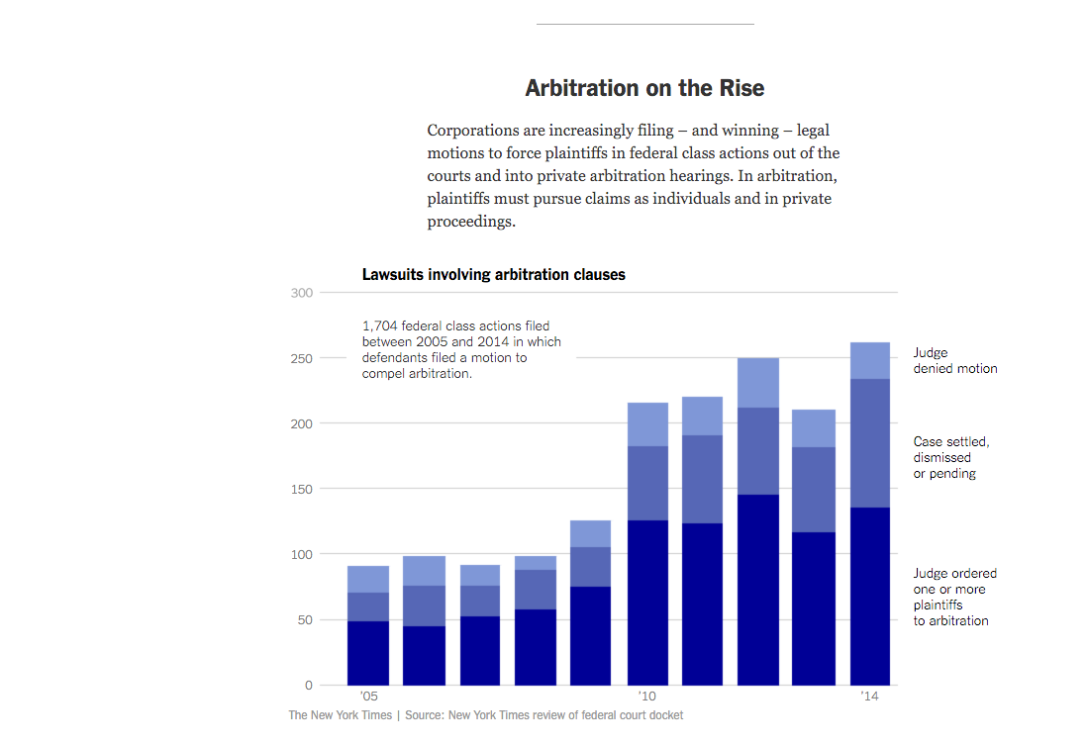
Marrying Data And Investigative Journalism Techniques
Robert Gebeloff -- @gebeloffnyt- DATAHARVEST 2016

Slide 56
Marrying Data And Investigative Journalism Techniques
Becoming well known that U.S. companies insert “arbitration” clauses in many consumer and employment contracts curtailing rights to bring lawsuits
But how did this come about? And how often does it happen? And what happens in arbitration cases?
Investigative reporters start to dig in but realize they need help
Robert Gebeloff -- @gebeloffnyt- DATAHARVEST 2016

Slide 57
Marrying Data And Investigative Journalism Techniques
One U.S. state – California – passes law requiring all firms that conduct arbitrations to file “disclosure” files for all cases they handle in the entire U.S.
But these files are a mess. No standards in what fields the firms disclose, or the data format.
Solution: Ability to convert any format into a tabular information; Reporting to determine which fields of information are comparable across companies
Robert Gebeloff -- @gebeloffnyt- DATAHARVEST 2016

Slide 58
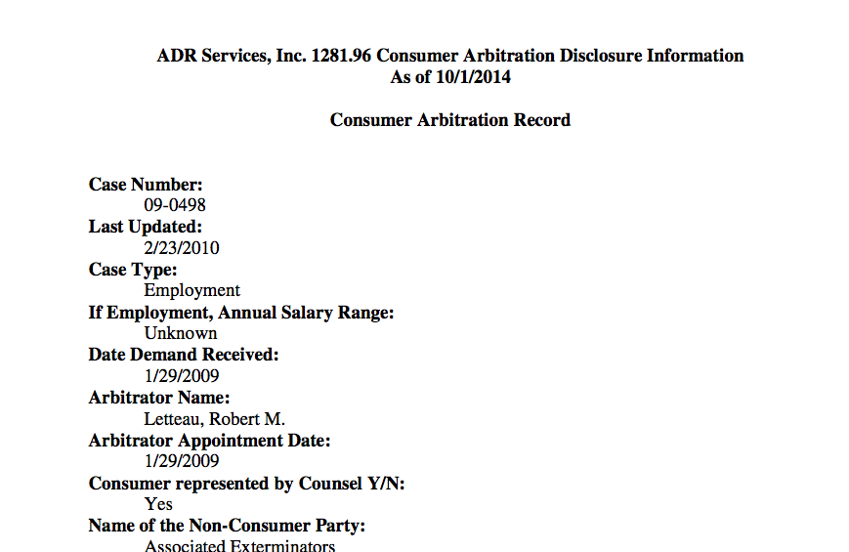

Slide 59
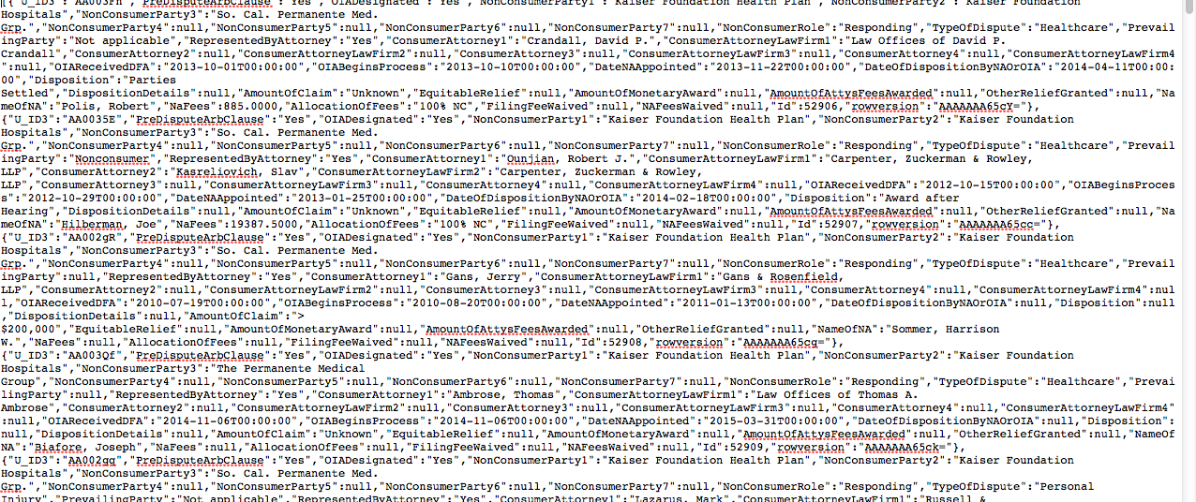

Slide 60
Marrying Data And Investigative Journalism Techniques
Reporting shows that the biggest impact is at the Federal level, with “class action” lawsuits – multiple small plaintiffs pooling their resources to take on large corporations.
To get at this: Custom search of Westlaw (commercial service) U.S. court dockets; Converting text of dockets into tabular data; Reading each case and collecting additional data – what type of case? What did the judge decide? Etc.
Robert Gebeloff -- @gebeloffnyt- DATAHARVEST 2016

Slide 61
Marrying Data And Investigative Journalism Techniques
The Times investigation was based on thousands of court records and interviews with hundreds of lawyers, corporate executives, judges, arbitrators and plaintiffs in 35 states.
Since no government agency tracks class actions, The Times examined federal cases filed between 2010 and 2014. Of 1,179 class actions that companies sought to push into arbitration, judges ruled in their favor in four out of every five cases.
In 2014 alone, judges upheld class-action bans in 134 out of 162 cases.
Robert Gebeloff -- @gebeloffnyt- DATAHARVEST 2016

Slide 62
Marrying Data And Investigative Journalism Techniques
But by assembling records from arbitration firms across the country, The Times found that between 2010 and 2014, only 505 consumers went to arbitration over a dispute of $2,500 or less.
Verizon, which has more than 125 million subscribers, faced 65 consumer arbitrations in those five years, the data shows. Time Warner Cable, which has 15 million customers, faced seven.
One federal judge remarked in an opinion that “only a lunatic or a fanatic sues for $30.”
Robert Gebeloff -- @gebeloffnyt- DATAHARVEST 2016

Slide 63
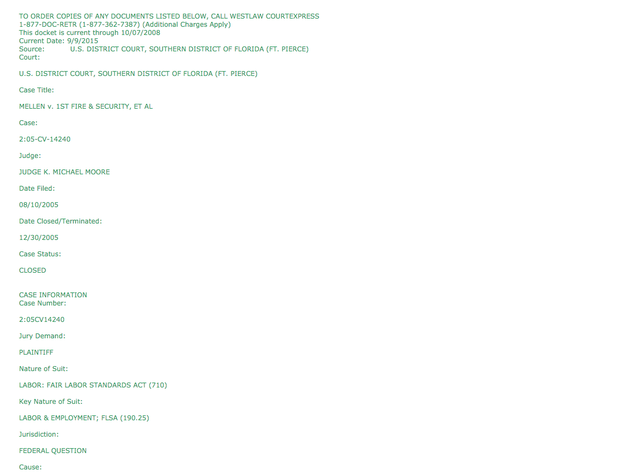
Marrying Data And Investigative Journalism Techniques
Robert Gebeloff -- @gebeloffnyt- DATAHARVEST 2016

Slide 64
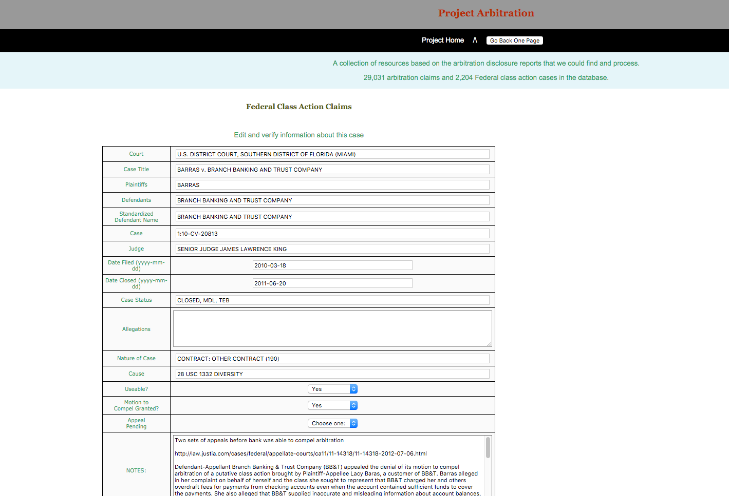
Marrying Data And Investigative Journalism Techniques
Robert Gebeloff -- @gebeloffnyt- DATAHARVEST 2016

Slide 65
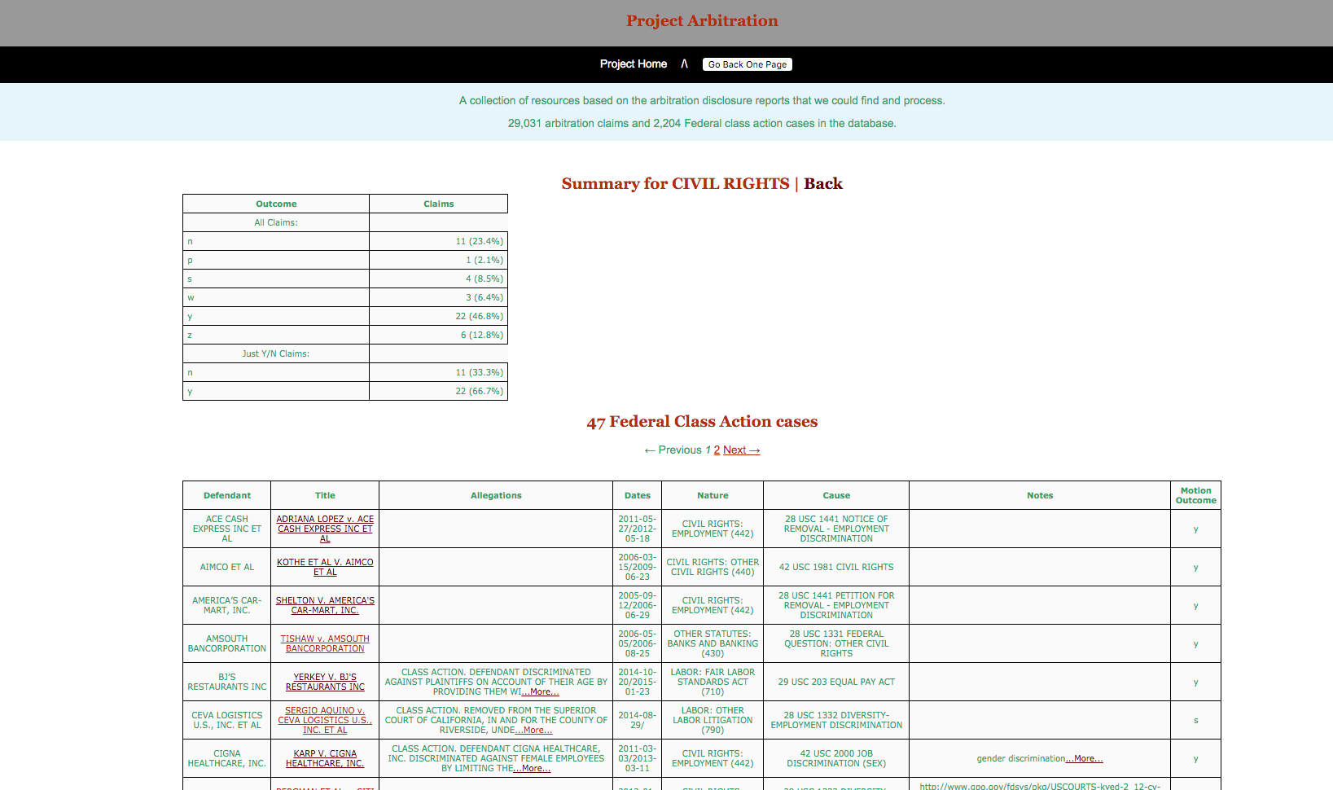
Marrying Data And Investigative Journalism Techniques
Robert Gebeloff -- @gebeloffnyt- DATAHARVEST 2016

Slide 66
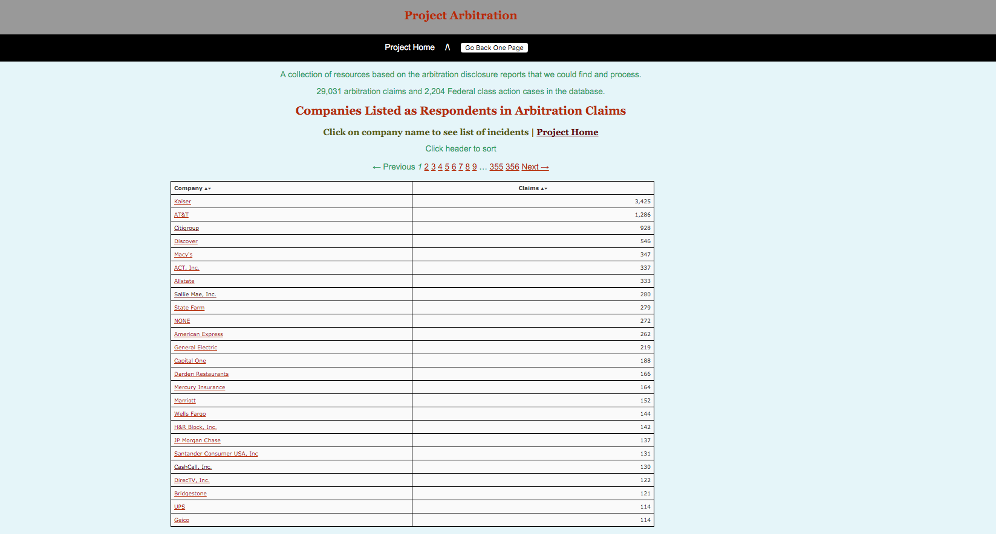
Marrying Data And Investigative Journalism Techniques
Robert Gebeloff -- @gebeloffnyt- DATAHARVEST 2016

